Slide 1


Roy S Verstegen
5/2/2024

Slide 2

Table Of Contents
Executive Summary – p3
Introduction – p4
Methodology – p5
Results
Conclusion
Appendix

Slide 3
Executive Summary
Space X advertises Falcon 9 rocket launches at a cost of 62 million dollars; other providers cost upward of 165 million dollars each, much of the savings is because Space X can recover and reuse the first stage. Therefore, if we can determine if the first stage will land successfully, we can determine the cost of a launch. This information can be used if an alternate company wants to bid against space X for a rocket launch.
These findings will determine which features give us the best chance to recover and reuse the first stage of a rocket launch. The list of features include
Orbit
Payload Mass
Booster Versions
Launch Sites
Based on these features, the best Machine Learning supervised classification model developed in this report, predicted booster recovery outcome with an accuracy close to 94%.

Slide 4
Introduction
Project background and context
Space X advertises Falcon 9 rocket launches with a cost of 62 million dollars; other providers cost upward of 165 million dollars each, much of the savings is because Space X can reuse the first stage. Therefore, if we can determine if the first stage will land, we can determine the cost of a launch. The goal of the project is to create a machine learning pipeline to predict if the first stage will land successfully.
Problems you want to find answers
What features determine if the rocket will land successfully?
The relationship among features that determine the success rate of a first stage recovery and landing.
What operating conditions ensure a successful landing.

Slide 5

Section 1

Slide 6
Methodology
Data collection methodology:
Sqlite3 (Db2) database
SpaceX REST API
Web scraping (Beautiful Soup)
Pandas data frame
Csv files

Slide 7
Methodology
Perform data wrangling
One-hot encoding was applied to categorical features.
Identified missing values and replaced with mean value.
Added categorical column for success or failure of outcome.

Slide 8
Methodology
Perform exploratory data analysis (EDA) using visualization and SQL
Created database to store and retrieve data collected
Load data into Db2 database
Used SQL to determine which launch sites have the highest success
Used SQL to determine which booster versions have the highest success

Slide 9
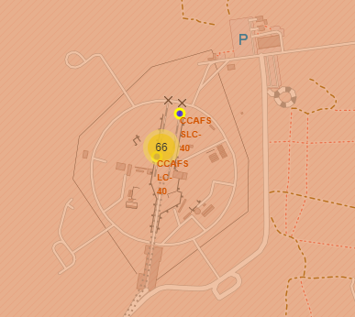
Methodology
Perform interactive visual analytics using Folium and Plotly Dash
Built Maps of launch sites
Counted success/failure rate at each launch site

Slide 10
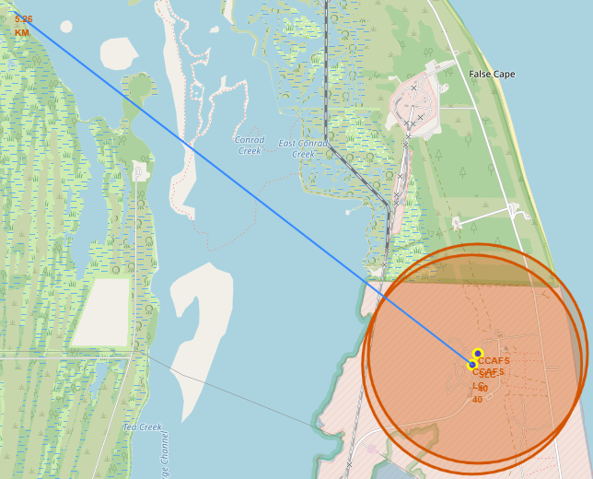
Methodology
Perform predictive analysis using classification models
Used Train, test, split function to create test data and train data
Measured distance from cities, railways, and coastlines

Slide 11
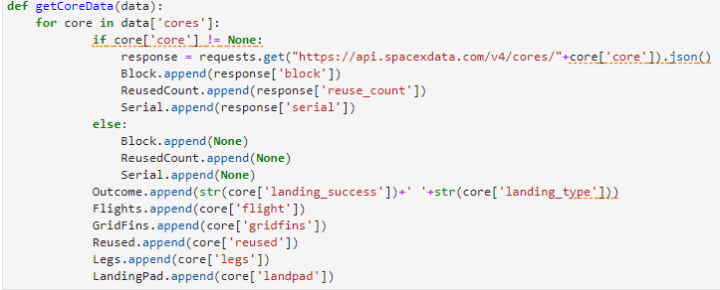
Data Collection
SpaceX REST API – used get-response methodology and placed data in pandas dataframe.
Complete file located - https://github.com/verroy/FinalCapstone.git

Slide 12
Data Collection
You need to present your data collection process use key phrases and flowcharts
Web Scraping – scrapped html table data from Wikipedia site and placed it into dictionary format for analysis.
Database – converted csv file to database table format and queried table to determine counts of landing outcomes, booster versions, and mission success or failures.

Slide 13
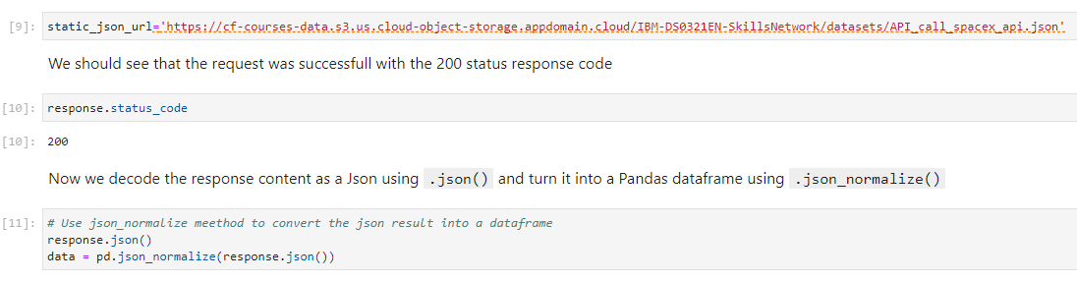
Data Collection – SpaceX API
Collected Json datasets
Normalized Json data
Placed the data sets into pandas dataframe
Complete Package located here - https://github.com/verroy/FinalCapstone.git
Place your flowchart of SpaceX API calls here

Slide 14
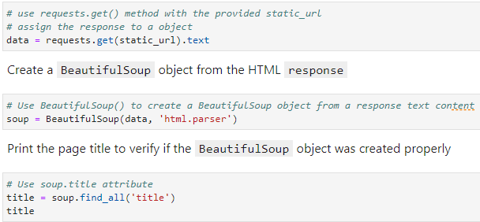
Data Collection - Scraping
Web scraping using Beautiful Soup
Used Get-Response html methods
Retrieved data from html table tags
Complete notebook at - https://github.com/verroy/FinalCapstone.git
Place your flowchart of web scraping here

Slide 15
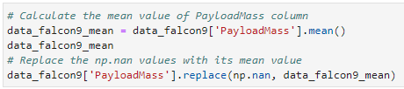
Data Wrangling
Missing data was replaced with the mean value for Payload Mass
Examined the dataframe for missing data and Payload Mass had 5 missing values and Landing Pad had 26 missing values. Payload Mass was replaced with mean value and Landing Pad was left as null value.
https://github.com/verroy/FinalCapstone.git

Slide 16
EDA with Data Visualization
Scatter Plots were used to determine flight number vs payload mass and Payload vs Launch Site.
Catplot was used to determine flight number vs launch site, Orbit vs Flight Number, and Orbit vs PayLoad Mass.
Bar chart was used to determine success rate vs Orbit
Line Charts were used to Measure success rate per year.
For complete notebook - https://github.com/verroy/FinalCapstone.git

Slide 17
EDA with SQL
Queried database tables to list the following data points…
Distinct Launch Sites
Total Payload Mass and average carried by Booster
Determine the first date of successful mission outcome
Determine the drone ship successful booster version
Counted Mission Outcomes and landing outcomes
Calculated the maximum payload mass by Booster Version
Complete notebook at - https://github.com/verroy/FinalCapstone.git

Slide 18
Build an Interactive Map with Folium
The following markers, circles, colors and lines were created on folium map
Markers, Circles, Colors, and Lines
They were added to determine success rates
They were added to measure distance between launch sites and railways, Cities, and Coastlines.
Complete notebook located here - https://github.com/verroy/FinalCapstone.git

Slide 19
Build a Dashboard with Plotly Dash
Two interactive plots and graphs were built
Pie Graph
Scatter plot
Pie graph was used to measure successful launches per launch site.
Scatter plot was used to measure Payload Mass per class
Complete notebook located here - https://github.com/verroy/FinalCapstone.git

Slide 20
Predictive Analysis (Classification)
The following classifications were used –
Logistic Regression
Support Vector Machine
Decision Tree
K-Nearest Neighbor
After the dataset was split using test_train_split, each classification was fit to the model and the accuracy measured using score, and a confusion matrix.
Complete notebook located here - https://github.com/verroy/FinalCapstone.git

Slide 21

Section 2

Slide 22
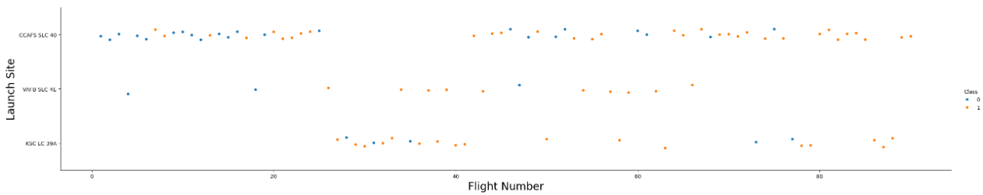
Flight Number vs. Launch Site
Blue Dot (0) – means the mission Outcome was un-successful landing the first stage
Orange Dot (1) – means the mission Outcome was successful landing the first stage

Slide 23
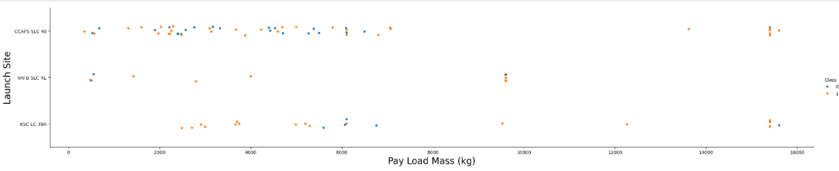
Payload vs. Launch Site
Launch Site VAFB-SLC had no rockets launched for a payload mass greater than 10,000 lbs

Slide 24
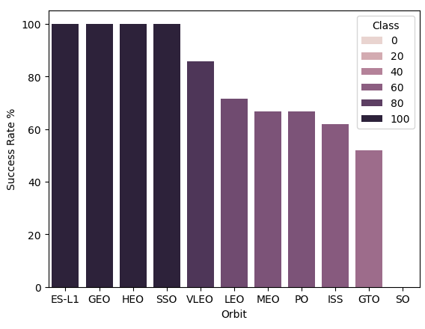
Success Rate vs. Orbit Type
Certain Orbits had higher success rates than others.

Slide 25
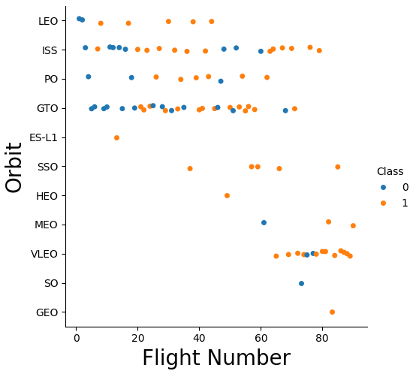
Flight Number vs. Orbit Type
The LEO orbit success appears related to the number of flights.
GTO Orbit seems to have no relationship between flight number and success.

Slide 26
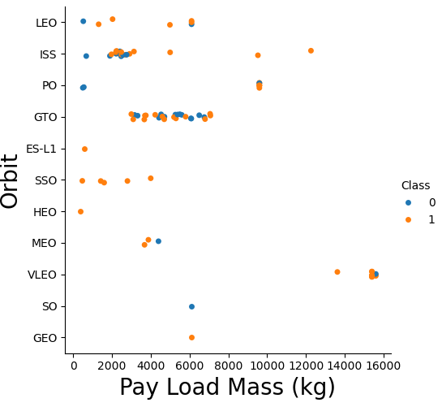
Payload vs. Orbit Type
Polar, LEO, and ISS have positive landing rates with heavy payloads.
GTO is harder to distinguish

Slide 27
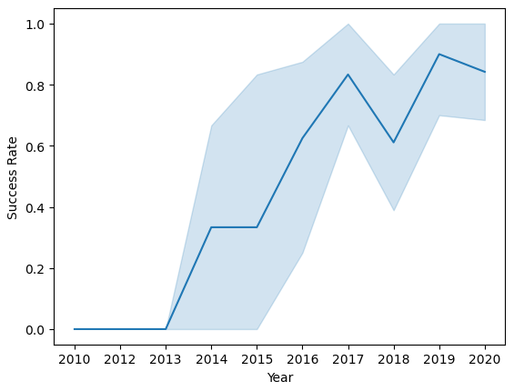
Launch Success Yearly Trend
Landing success rate kept climbing since 2013 until 2018.

Slide 28
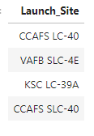
All Launch Site Names
The launch Site Names
Used the Distinct function to query the launch site names.
select Distinct("Launch_Site") from SPACEXTBL;

Slide 29
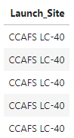
Launch Site Names Begin with 'CCA'
Find 5 records where launch sites begin with `CCA`
Used like in the where clause and limit to 5 records
select Launch_Site from SPACEXTBL where Launch_Site like 'CCA%' limit 5

Slide 30
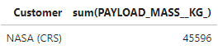
Total Payload Mass
Calculate the total payload carried by boosters from NASA
select Customer, sum(PAYLOAD_MASS__KG_) from SPACEXTBL where Customer = 'NASA (CRS)' group by Customer

Slide 31
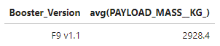
Average Payload Mass by F9 v1.1
Calculate the average payload mass carried by booster version F9 v1.1
Display the average payload mass carried by booster version F9 v1.1
select Booster_Version, avg(PAYLOAD_MASS__KG_) from SPACEXTBL where Booster_Version = 'F9 v1.1' group by Booster_Version

Slide 32
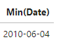
First Successful Ground Landing Date
Find the dates of the first successful landing outcome on ground pad
List the first successful landing outcome in ground pad, used the min functions
select Min(Date) from SPACEXTBL where Mission_Outcome = 'Success’;

Slide 33
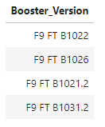
Successful Drone Ship Landing with Payload between 4000 and 6000
List the names of boosters which have successfully landed on drone ship and had payload mass greater than 4000 but less than 6000
select Distinct(Booster_Version) from SPACEXTBL where PAYLOAD_MASS__KG_ between 4000 and 6000 and Landing_Outcome = 'Success (drone ship)’

Slide 34
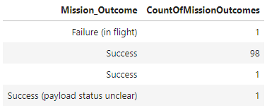
Total Number of Successful and Failure Mission Outcomes
Calculate the total number of successful and failure mission outcomes
select Mission_Outcome, Count(Mission_Outcome) as CountOfMissionOutcomes from SPACEXTBL group by Mission_Outcome

Slide 35
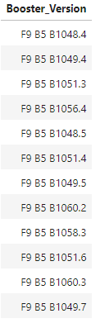
Boosters Carried Maximum Payload
List the names of the booster which have carried the maximum payload mass
Used a subquery
select Booster_Version from SPACEXTBL where PAYLOAD_MASS__KG_ in (Select max(PAYLOAD_MASS__KG_) from SPACEXTBL)

Slide 36
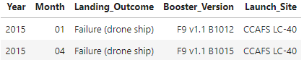
2015 Launch Records
List the failed landing_outcomes in drone ship, their booster versions, and launch site names for in year 2015
select substr(Date,0,5) as Year, substr(Date,6,2) as Month, Landing_Outcome, Booster_Version, Launch_Site from SPACEXTBL where Landing_Outcome = 'Failure (drone ship)’ and Year = 2015

Slide 37
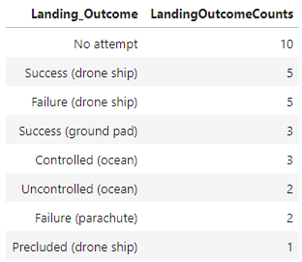
Rank Landing Outcomes Between 2010-06-04 and 2017-03-20
Rank the count of landing outcomes (such as Failure (drone ship) or Success (ground pad)) between the date 2010-06-04 and 2017-03-20, in descending order
select Landing_Outcome, Count(Landing_Outcome) as LandingOutcomeCounts from SPACEXTBL where Date >= '2010-06-04' and Date <= '2017-03-20' group by Landing_Outcome order by Count(Landing_Outcome) desc

Slide 38

Section 3

Slide 39
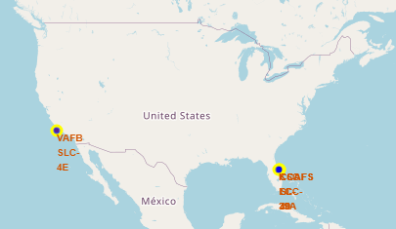
Launch Sites
Explore the generated folium map and make a proper screenshot to include all launch sites’ location markers on a global map
The launch sites are in close proximity to coastlines.

Slide 40
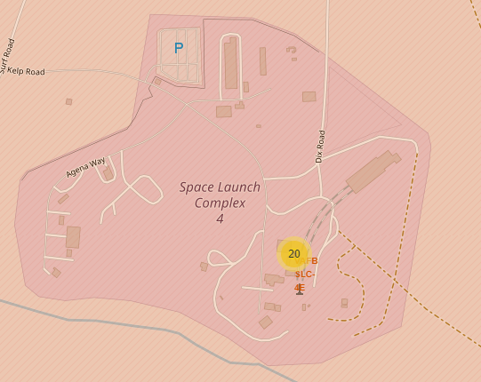
Launches per Site
Explore the folium map and make a proper screenshot to show the color-labeled launch outcomes on the map
Colored labels to mark number of launches

Slide 41
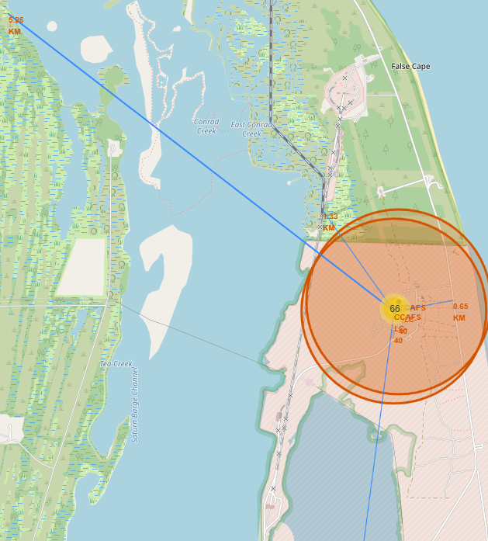
Launch Site proximity to Cities, Railway, and Coast
Explore the generated folium map and show the screenshot of a selected launch site to its proximities such as railway, highway, coastline, with distance calculated and displayed
We should launch rockets close to coastlines. This folium map plots line distances from Cities, railways, and coastlines.

Slide 42

Section 4

Slide 43
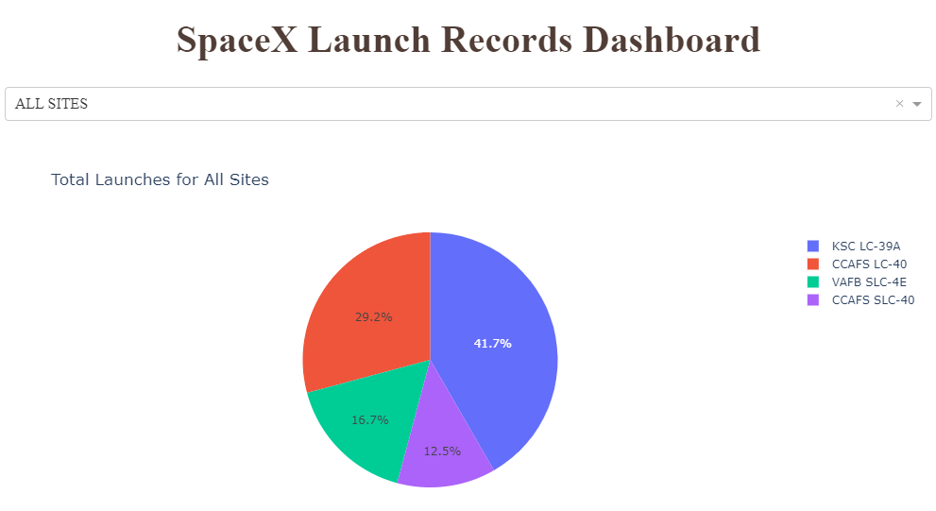
Launch Records Dashboard
Show the screenshot of launch success count for all sites, in a piechart
Which launch sites have a higher percentage of mission outcomes.

Slide 44
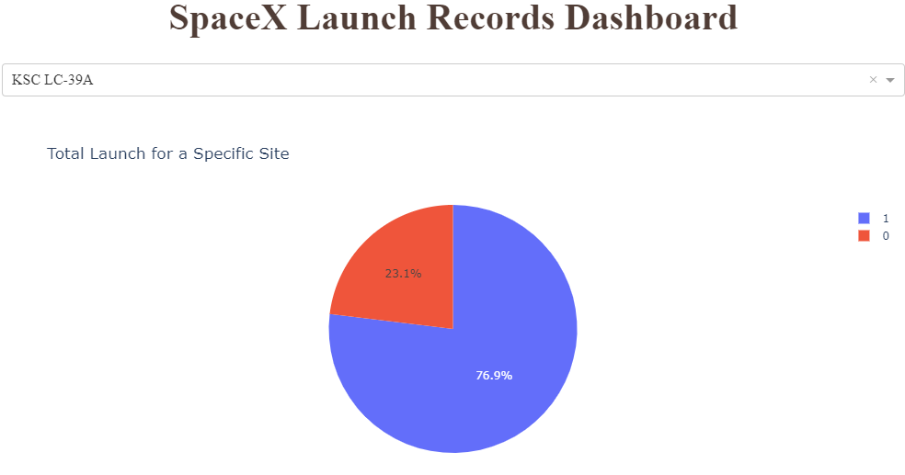
KSC LC-39A Launch Site
Show the screenshot of the piechart for the launch site with highest launch success ratio
What is the success rate for KSC LC-39A

Slide 45
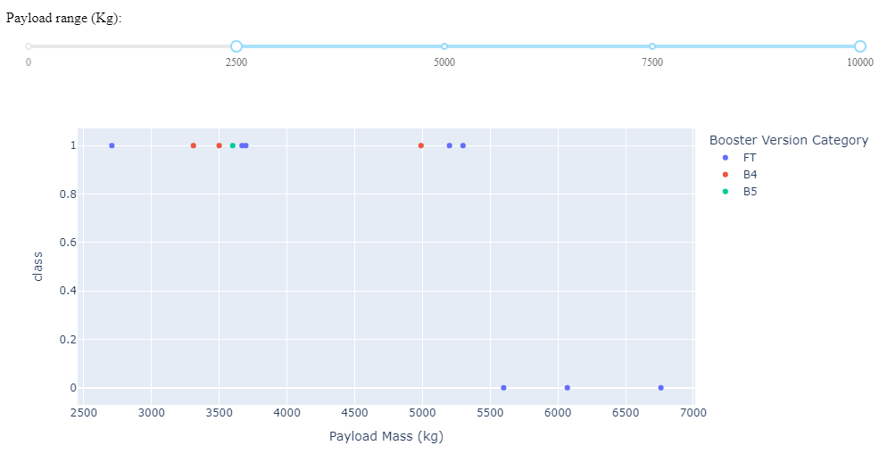
Booster Version at 2500 kg
Show screenshots of Payload vs. Launch Outcome scatter plot for all sites, with different payload selected in the range slider
Which versions perform better at 2500 kg

Slide 46

Section 5

Slide 47
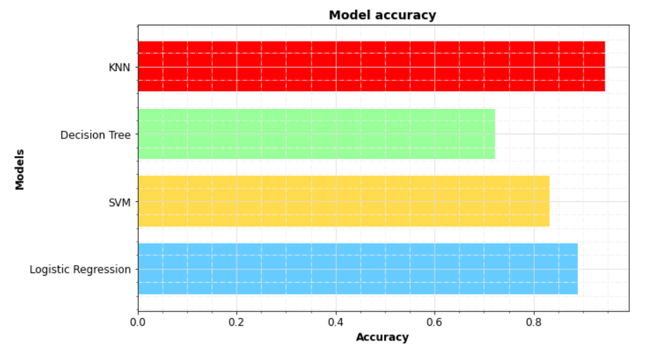
Classification Accuracy
With train test split random state set = 3. KNN shows a 94% accuracy rate.
Optimization of SVM and LR hyper-parameters was refined for increasing accuracy with train set. Test set is too small.

Slide 48
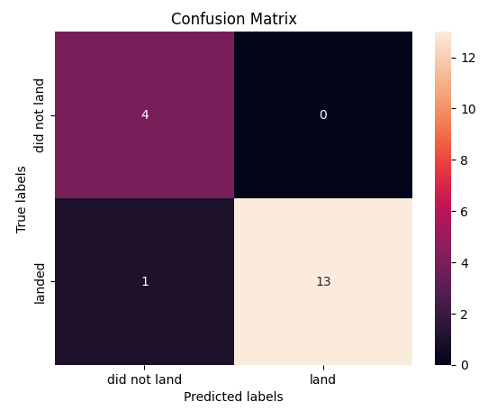
Confusion Matrix
K-Nearest Neighbor is the best predictor
It successfully predicted 100% of the did not land
It only missed one of the landed.

Slide 49
Conclusions
We defined success as a successful recovery process of Falcon9 first stage booster.
Based on these features, we selected a supervised classification model capable of predicting launch outcome with a 94% accuracy.
Falcon9 first stage booster recovery seems to improve over time.
Recent successes with FT boosters landing on “drone ship”, bodes well for such a solution.

Slide 50
Appendix
Include any relevant assets like Python code snippets, SQL queries, charts, Notebook outputs, or data sets that you may have created during this project
All notebooks can be found in the Github repository at https://github.com/verroy/FinalCapstone.git

Slide 51


